Slide 1
SHREC’17: RGB-D to CAD Retrieval with ObjectNN Dataset
Eurographics Workshop on 3D Object Retrieval
Binh-Son Hua
Singapore University of Technology and Design
Notes:
Hi everyone,
Today I am going to present the paper SHREC’17: RGB-D to CAD retrieval with ObjectNN dataset. This paper summarizes our results from the SHREC challenge that we held during January and Feb, as a part of the Eurographics workshop on 3D object retrieval.
My name is Binh-Son Hua, and I am from Singapore University of Technology and Design.

Slide 2
Participation: 5 external groups
Asako Kanezaki
Bo Li
Yijuan Lu
Henry Johan
Shoki Tashiro
Masaki Aono
Minh-Triet Tran
Viet-Khoi Pham
Hai-Dang Nguyen
Vinh-Tiep Nguyen
Quang-Thang Tran
Thuyen V. Phan
Bao Truong
Minh N. Do
Anh-Duc Duong
Binh-Son Hua
Quang-Trung Truong
Minh-Khoi Tran
Quang-Hieu Pham
Lap-Fai Yu
Duc Thanh Nguyen
Sai-Kit Yeung
Tang Lee
HungYueh Chiang
Winston Hsu
Notes:
Before talking about technical details, I would like to thank 5 external groups for their kind participation and great contribution in this object retrieval challenge. The names of all co-authors of the paper are listed in this slide. You can find more details about their affiliations in the paper.

Slide 3
RGB-D dataset
http://www.scenenn.net
SceneNN: 100+ indoor scenes
Raw videos with 2,000 - 10,000 frames each
Reconstructed into triangle meshes
Fully annotated
Per-frame camera poses
Per-vertex and per-pixel labelling
Annotated bounding boxes, object poses
Notes:
Now I would like to briefly discuss about the motivation of this object retrieval challenge. We are inspired from the recent publication of several indoor RGB-D and CAD model datasets.
Here we use SceneNN, an RGB-D dataset packed with more than 100 scenes. Compared to previous RGB-D dataset such as SUN3D and the SceneNet, this dataset is captured from the real-world indoor scenes and fully annotated.
Each scene in this dataset has thousands of frames. Each scene is reconstructed into a triangle mesh.
It contains both dense 2D pixel and 3D vertex annotation. It also comes with bounding boxes and object poses.
Here are a few examples.

Slide 4
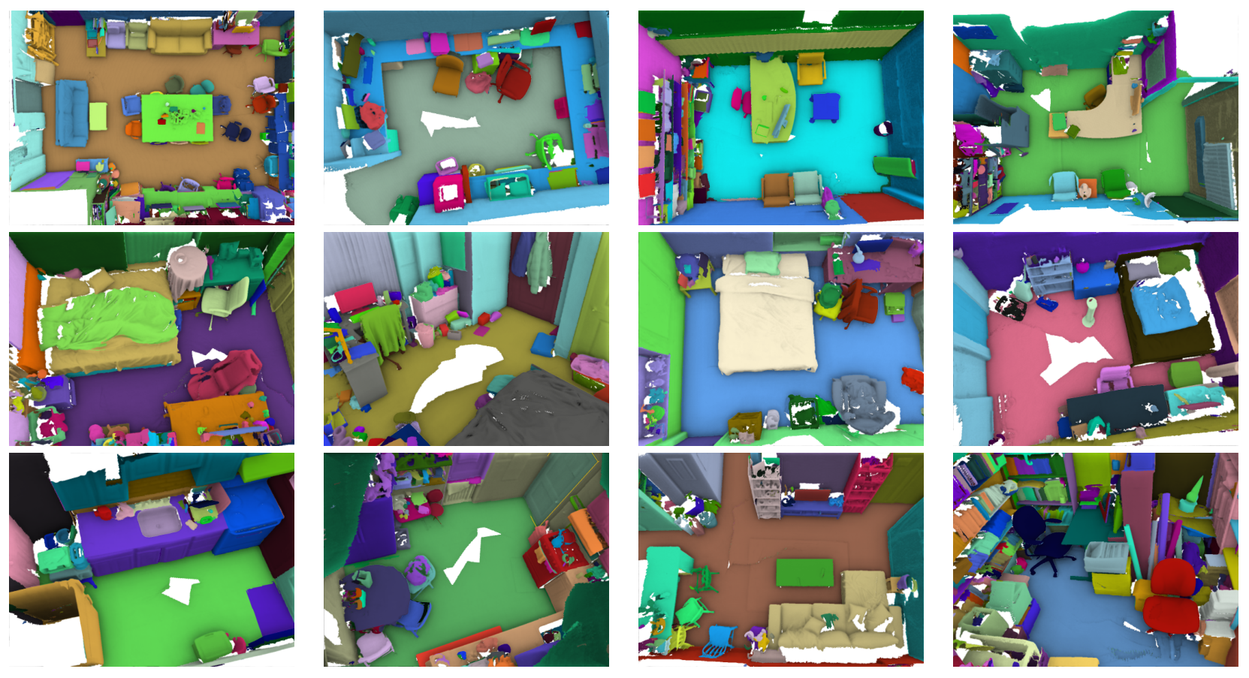
Notes:
Here are some other examples.

Slide 5
Applications
(+) Thousands of objects in real-world setting can be extracted.
(-) Partial shapes
Several computer vision applications:
Shape completion
Object recognition, detection
Object retrieval
Notes:
By extracting objects from such annotation, it is possible to obtain thousands of objects in real-world setting. This is in contrast to acquiring objects in laboratory, which can be much more slower and difficult to scale.
Such objects can be used for several computer vision problems such as object recognition, detection, shape completion, and so on. In this paper, we focus on object retrieval.

Slide 6
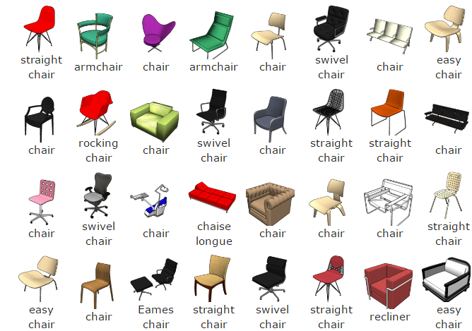
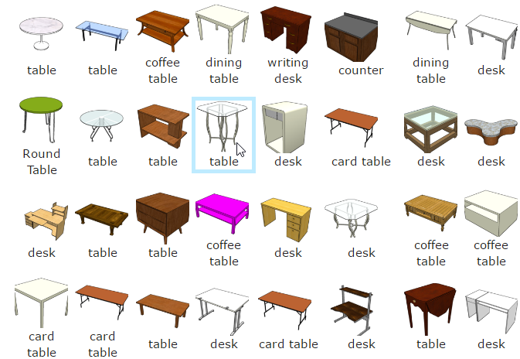
CAD dataset
https://www.shapenet.org
ShapeNet (ShapeNetSem)
Densely annotated 12,000 CAD models 270 categories
Notes:
Another notable dataset for CAD models is ShapeNet. Here we consider a smaller variant of ShapeNet, called ShapeNetSem, where the objects are carefully annotated including category and front and up direction. Here are some examples from the dataset: different types of chairs and tables.

Slide 7
RGB-D to CAD retrieval
Query: RGB-D object
Color and depth images
Triangle mesh
Target: CAD model
Triangle mesh
SceneNN
ShapeNet
ObjectNN
For each query, return a ranked list of retrieved CAD models
Notes:
And so by utilizing these two datasets, our retrieval problem is to match a RGBD object to a CAD model.
Query objects are RGB-D models, which are extracted from SceneNN, and target objects are CAD models, from ShapeNet.

Slide 8
Today’s talk
Motivation
ObjectNN ground truth
Retrieval approaches
Evaluation results
Future work
Notes:
This is the agenda of this talk. We have just talked about the motivation. In the next sections, I would like to share more details about how we built ObjectNN. We then briefly discussed typical approaches from the participants that tackles this retrieval problem. We then present the results and future work.

Slide 9
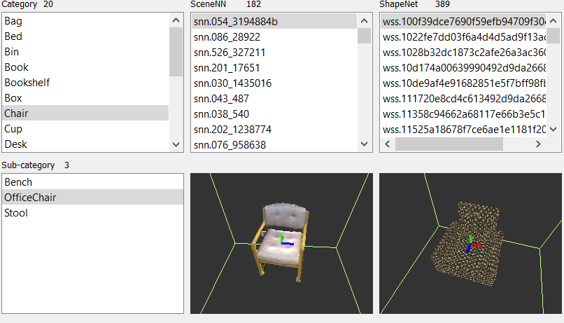
Making of ObjectNN
User interactive tool
Find common categories between SceneNN and ShapeNet
Select indoor objects
Assign labels
Discard too partial, sparse and noisy reconstruction
Categorization
User 1: categorize SceneNN objects
User 2: categorize ShapeNet objects
User 3: validation, discard categories with too few objects
Notes:
To make retrieval feasible, we have to relate objects in both SceneNN and ShapeNet. In order to do this, we built a customized user interactive tool that displays in 3D objects from both datasets. We allow user to navigate the datasets, edit and assign categories to each object pair.
While there are plenty of objects in SceneNN and ShapeNet, only objects belonged to the common categories can be used for our retrieval problem.
We asked three users to help annotate the objects. The first user handles SceneNN, the second ShapeNet, and the final user performs verification and check common categories.

Slide 10
ObjectNN
20 categories
1667 objects from SceneNN
3308 objects from ShapeNet
For supervised learning, split ratio: 50/25/25% for train, validation and test.
CAD models with categorization are made available publicly.
SceneNN
ShapeNet
Notes:
Here are the resulting dataset statistics and object distribution.
20 categories of common household items
1667 RGBD objects
3308 CAD models
To support supervised learning techniques, we split the objects into three sets (train, validation, test) with ratio 50, 25, 25.
We release the train and valiation set, together with all labels of the CAD models.
The test set only contains RGB-D models, and the labels are kept by private by the organizers during the challenge.

Slide 11
Evaluation criteria
Category of retrieved CAD model == category of query RGB-D object
Metrics:
Precision and recall
Mean Average Precision (mAP)
Normalized Discounted Cumulative Gain (NDCG)
General for both supervised and unsupervised techniques
Notes:
There are both pros and cons of using this evaluation criteria, which we will discuss at the end of this talk.

Slide 12
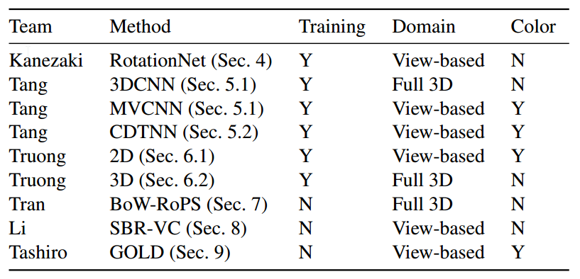
Methods overview
Object recognition
Feature matching
Notes:
In general, about 60% of the participants approached the problem using deep learning, while the remaining used traditional feature matching approaches. However, it is important to take note of the evaluation criteria, which gives mark for every category match. We observe that methods that exploit this hint achieves tangible results.

Slide 13
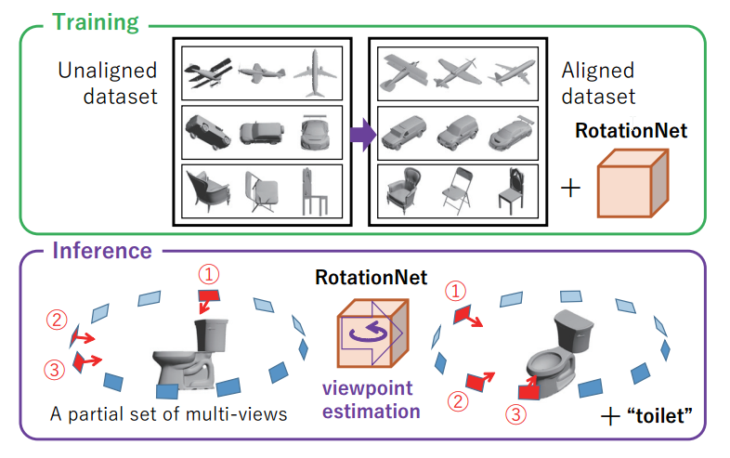
RotationNet (by Kanezaki)
Multi-view CNN.
Predict both category and pose label.
Pose as latent variable during training phase.
Robust to unaligned object recognition.
Notes:
As we provided the categories of CAD models, supervised learning techniques cast the retrieval problems into object recognition. Among deep learning techniques, view-based and 3D convolutional neural network are among the most popular strategies for object recognition.
The winner of this challenge uses a multi-view network that can estimate both object category and pose. This method excels at handling misaligned objects, resulting in its top-notch performance. Please refer to Section 4 of our paper for more technical details.
Extending RotationNet to 3D could be an interesting work.

Slide 14
3D Convolutional Neural Network (by Tang et al.)
Based on VoxNet [Maturana, IROS 2015]
With binary volume representation.
Competitive results to multi-view CNN methods.
Notes:
Another interesting approach that can produce very competitive results is 3D CNN. This network design follows VoxNet, but with more layers and higher input volume resolution. Its performance is about 3% lower than RotationNet in this challenge.

Slide 15
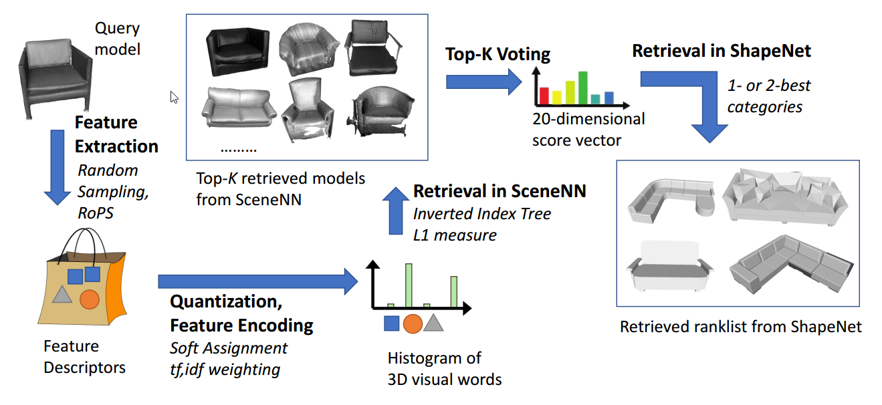
Bag-of-words (by Tran et al.)
Notes:
Instead of directly evaluating similarities between an RGB-D object and a CAD model, which is challenging and might not work reliably, the method by Tran et al. instead performed a retrieval in SceneNN itself, i.e., evaluating the similarities with remaining RGB-D objects. After determining the category of the query object, they can return the CAD models of the same category.

Slide 16
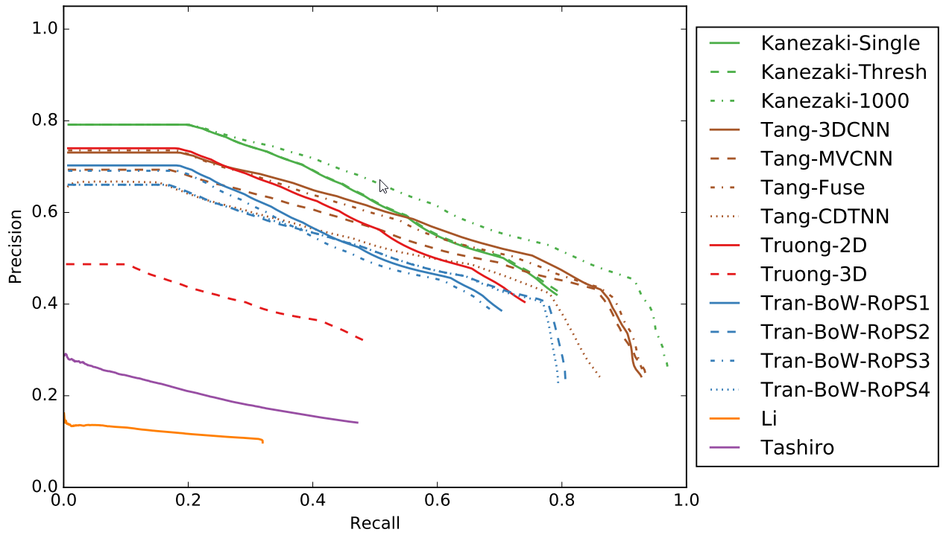
Precision-recall plot
Notes:
And here are the results. In this plot, we show that there are still rooms for improvement.

Slide 17
Precision per category
Notes:
We also attempt to plot the precision for each category, which helps reveal any bad categorization in our data. As expected, furniture categories such as chair, desk, display have good performance. There is still some ambiguity left for machine and printer class, which accuracy of the best method is only about 50%.

Slide 18
Future work
ObjectNN dataset extension
With objects from latest RGB-D datasets (SceneNN, ScanNet) and CAD models (SceneNet 5M)
Refine categories and classification
More challenging retrievals
No ground truth category for CAD models
Weakly segmented objects, e.g., with some background

Slide 19
Acknowledgement
We would like to extend our sincere gratitude and appreciation to
SUTD Digital Manufacturing and Design (DManD) Centre,
Singapore National Research Foundation (NRF) and the U.S. National Science Foundation (NSF),
University of Southern Mississippi Faculty Startup Funds Award.
Notes:
We thank … (as written on the slides)

Slide 20
Thank you!
ObjectNN data and evaluation code are available at:
https://github.com/scenenn/shrec17
Contact: binhson.hua@gmail.com

Slide 21
Previous SHREC tracks

